Slide 1
Culture Ate Our OKRs For Breakfast
Peter Lear Chief Product Owner, Nationwide Building Society
Kimberley Wilson Value Realisation Partner, Nationwide Building Society

Slide 2


Culture Ate Our OKRs For Breakfast
Peter Lear
Kimberley Wilson

Slide 3

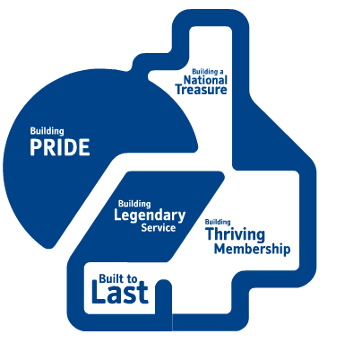
About Nationwide
World’s largest Building Society
Second largest Mortgage provider in the UK
Long running, traditional Organisation with embedded behaviours
Mutual Organisation – 1 member, 1 vote – 16 million members in the UK
Previous average time to value c.2 years
No. 1 for Customer Service in our peer group. UK’s most trusted financial brand
Benefits expectation misaligned to benefits realisation
£0.75bn of profit returned to our members last year
Mutual values lead to a natural risk sharing approach with collegiate decision making

Slide 4
OKRS & Value - Our Approach
“I take the position that I’m always in some degree wrong, and the aspiration is to be less wrong” Elon Musk
Thinking
Feedback & Learning
Reflection & Research
Experimenting
Problem Scoping

Slide 5




OKRs & Value - Progress So Far
“Aren’t OKRs just milestones?” OKR language was adopted but we underestimated the challenge of shifting the culture from ‘doing work’ to ‘realising value’.
Mandated OKR reporting for our entire Change Community
“Not Right Now” Senior Management too busy adapting to the volatile environment to support. Misalignment to Strategy was recognised but behaviours reinforced ‘doing work’ over ‘value’.
Attempted to gain support from Senior Management for a ‘Top Down’ approach
Test, Learn, Adapt, Repeat Demonstrated that, by supporting a behaviour shift, OKRs could be successful. Invaluable opportunity to learn and adapt. News of success filtered up to Senior Management and teams themselves highlighted any impediments.
Genuine interest from Middle Management. Supported teams to adopt OKR ‘culture’
Gathered feedback & learning to enable continuous improvement
Listening & Learning Changing our approach from mandating to supportive means we can gather much more feedback to continuously adapt and improve.

Slide 6



OKRs & Value - What are our challenges now?
… but we now have a renewed desire for change from our Customers.
Collaborative group discussion is required to embed OKRs across the Business, rather than top down instruction from leaders.
OKRs require different accountabilities, which is a difficult transition for both Delivery Teams & Central Oversight
The change in focus from ‘Doing Work’ to ‘Value Realisation’ is a challenging mindset shift.

Slide 7
OKR Evaluation – Feedback from Teams
What do you feel when setting outcomes and objectives at the moment?
How would you like to feel about Outcomes & Objectives in the future?
Boring & Generic
Visionary
Inspiring
Written then forgotten
Want to do them
Tick box Exercise
Don’t know the “Why?”
Measurable
Localised & Personal
Not valued, not rewarded
Regular check in

Slide 8






OKRs & Value – Building Next Level Thinking
Business Owned OKRs
Make OKRs visible throughout the Business, not just Change Teams. Dialogue & ‘buy in’ from all impacted areas is essential.
Tailor Support & Coaching
Step Changes, Not Marathons
Support teams to visualise their Value Story, helping them to highlight uncertain assumptions & risks to Value
Aim for improving small increments, rather than leaping to the end goal. Behaviour change is tough & requires adequate support.
Value Measurement
Course Correction is OK!
Accept ‘Good Enough’
Instil a focus on Value Measurement. Demonstrate how leading indicators can predict risks to value realisation.
Become an advocate for course correction. Showcase examples of teams course correcting to achieve more Value.
Accept ‘good enough’ improvement, then course correct. This builds psychological safety leading to genuine behaviour change.

Slide 9

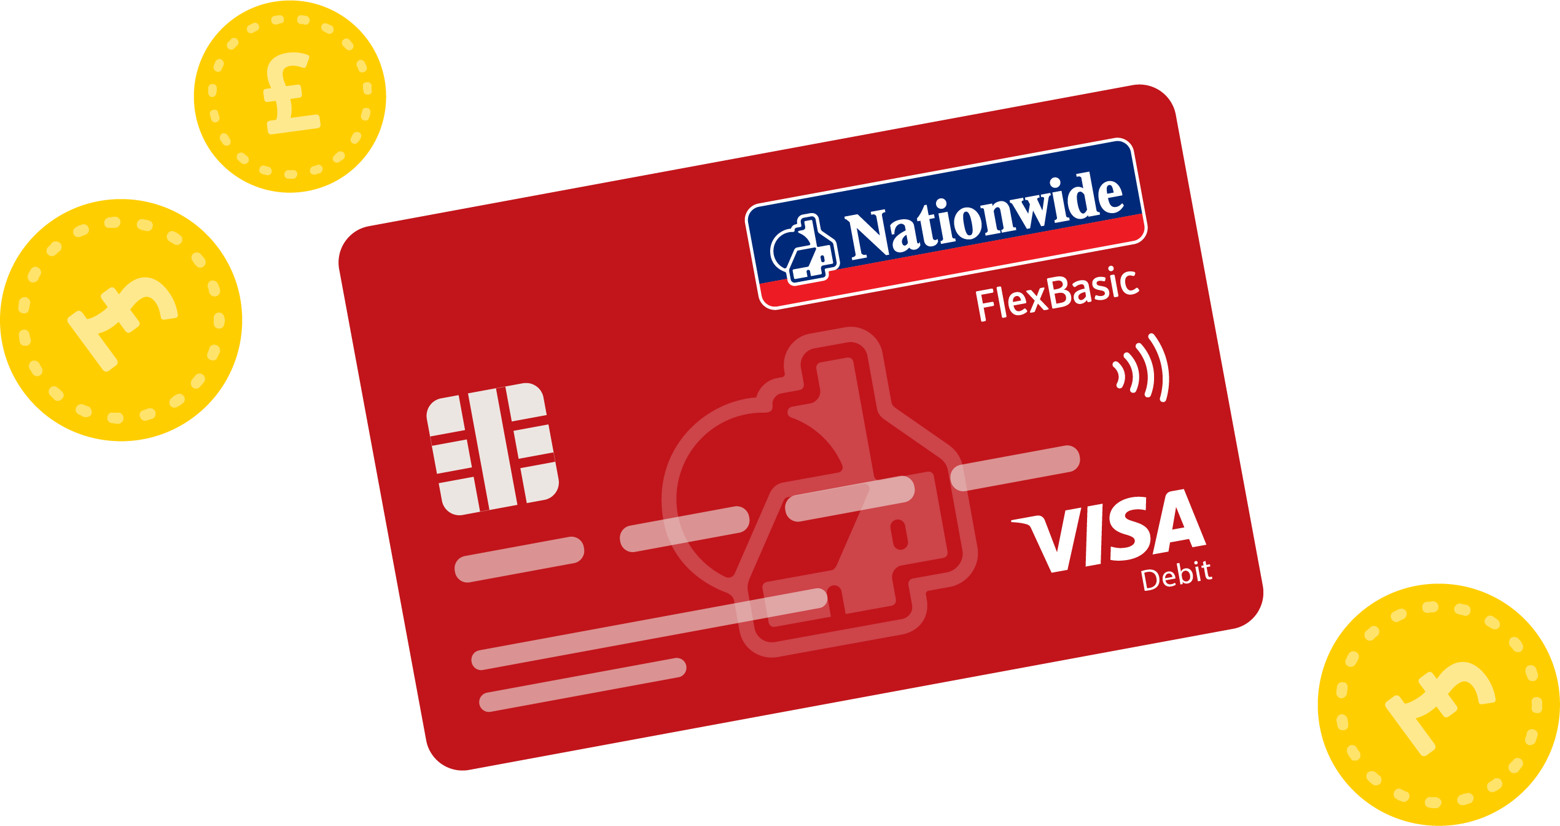















Example Support
Do I know the LATEST INFORMATION?
Who are my CUSTOMERS?
Revenue
Who will realise the benefits from your work (this might be business areas or a member base or both).
Member
Lagging Metrics
Have you kept regular dialogue with everyone in your value chain i.e. benefiting business areas & the teams exploiting. You need to know whether they are still prioritising your change.
Cost
Risk
Is there a DEMAND PULL?
Are there any assumptions?
Have you checked that the benefiting members or business area genuinely wants your capability? If not, what capability do they want?
What are my ASSUMPTIONS?
Example Leading Metrics
Leading Metrics
What are my assumptions that leading metrics will result in lagging metrics? Can I test these are still valid?
FTE Numbers
Market Share
Fast Feedback i.e. Complaints
No. of Users
Regulator Sanctions
Controls Breached
When & How will they EXPLOIT IT?
Step 1. Build it
Is EXPLOITATION required to unlock value? (potentially from another Team)
Will your capability realise value immediately or does another Team need to exploit it first i.e. switch on the app. Is the other Team keen to fund the exploitation?
Step 2. Make it available
Is Value Delivered FAST?
Step 3. USE IT
Is there a ‘minimum’ product I can launch and test with customers first? Can I deliver value in incremental chunks?
Capabilities
Capabilities delivered by Teams

Slide 10
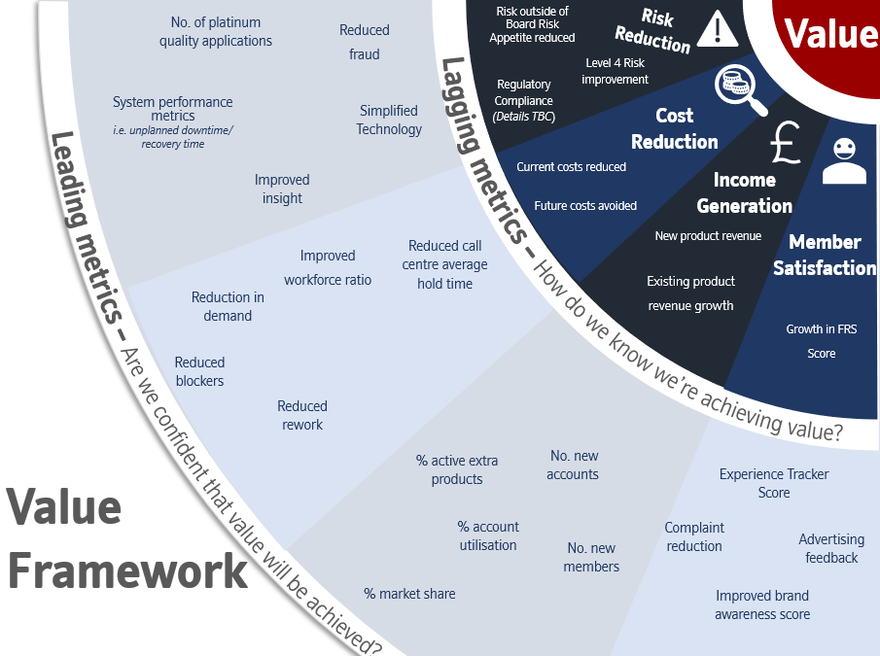
Example Support

Slide 11






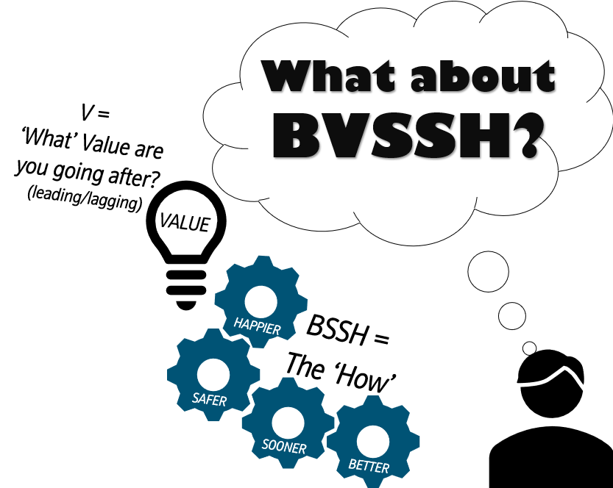





Example Support
Leading and Lagging are the more persistent measures that the Mission will always monitor and try to improve (similar to KPIs)
How can I measure VALUE?
Lagging Indicators
What are we ultimately trying to achieve?
Leading Indicators
There may be multiple Objectives aiming to move the same leading or lagging indicator
How can you get early confidence that Value will be achieved?
TOP TIPS
Objective
Be pragmatic (don’t create a measuring industry)
Use Leading Indicators & Key Results to help you course correct (they aren’t just for reporting)
Tracked by the Team delivering the Objective
Key Results tell you in a measurable way how the Objective is progressing
Key Results
How will you know your Objective is reaching success?

Slide 12




Example Support
Key Results and Leading Indicators can give you an invaluable early warning that different decisions need to be made.
My Lagging Indicator hasn’t improved…
WHy Measure VALUE?
After 2 years of work, Member Satisfaction has not increased.
PROBLEM:
My LEADING Indicators aren’t improving…
Member Satisfaction
Objective delivered
PROBLEM:
We’re delivering Objectives but the queue time leading indicator is not decreasing.
NONE! It’s usually too late to course correct if you are only monitoring your Lagging Indicator. To course correct early, keep a close eye on your Key Results and Leading Indicators instead.
My Key Results Haven’t been achieved…
SOLUTION:
Queue time leading indicator
Objective delivered
Objective delivered
PROBLEM:
I’ve delivered my Telephone Banking System but not all my Key Results have been achieved.
SOLUTION:
GOOD NEWS! You’ve spotted early that you may need to course correct to realise Value.
KEY RESULTS:
Why haven’t the Objectives affected the Leading Indicator?
Are there any other factors which have impacted the Leading Indicator?
What different decisions could we make to move the Leading Indicator?
System delivered
Queue time less than 2 mins
Staff ‘ease of use’ survey scores above 80%
SOLUTION:
GOOD NEWS! You’ve spotted early that your Objective might not realise Value. Now you can course correct.
What stopped your Key Results from being achieved?
If you don’t achieve those Key Results, what will the impact be?
What can you do now to course correct?

